Slide 1

Mobile App Development II COMP3097
Lecture 2
Przemyslaw Pawluk

Slide 2
Table of contents
Loops
Functions in Swift
Object-oriented programming in Swift

Slide 3
Loops

Slide 4
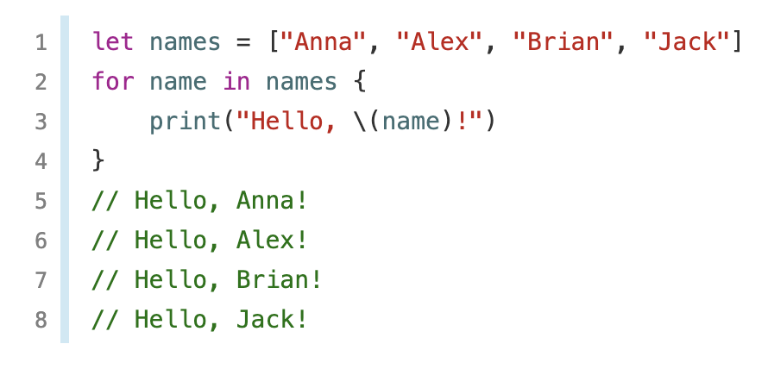
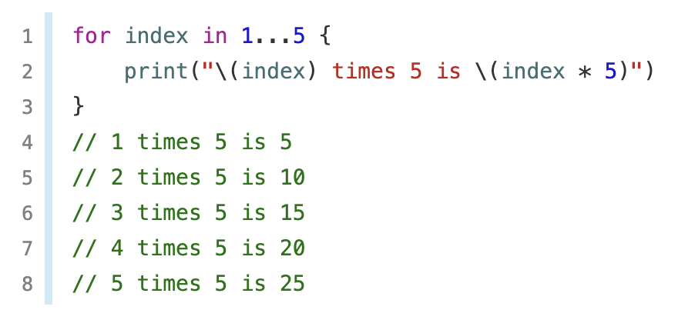
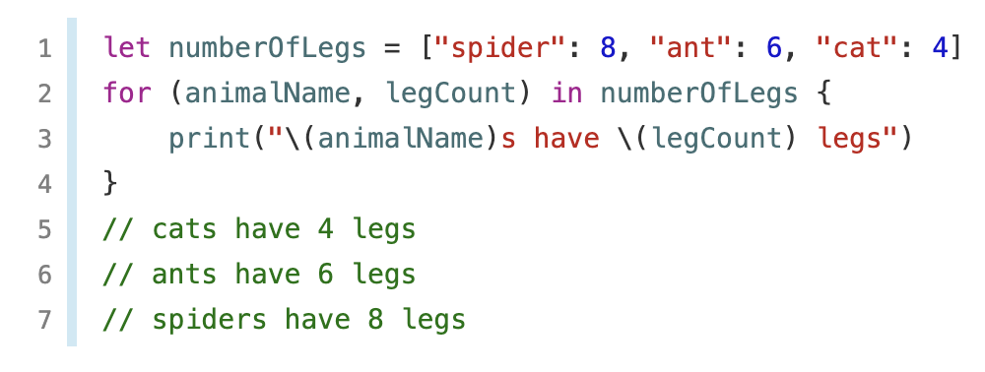
For-in numbers
You use the for-in loop to iterate over a sequence, such as items in an array, ranges of, or characters in a string.

Slide 5
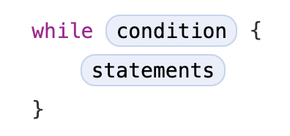
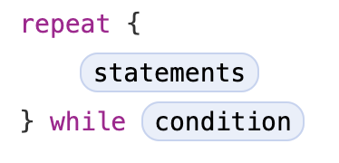
While loops
A while loop performs a set of statements until a condition becomes false. These kinds of loops are best used when the number of iterations is not known before the first iteration begins. Swift provides two kinds of while loops:
while evaluates its condition at the start of each pass through the loop.
repeat-while evaluates its condition at the end of each pass through the loop.

Slide 6
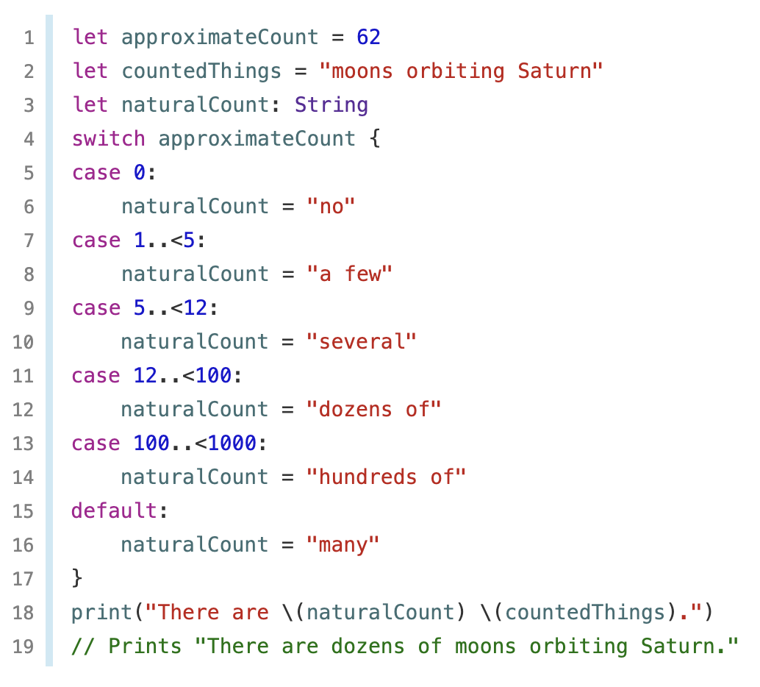
Interval matching in switch
Values in switch cases can be checked for their inclusion in an interval.
This example uses number intervals to provide a natural-language count for numbers of any size:

Slide 7
Functions

Slide 8
Functions
A function is a collection of statements to carry out a particular assignment together.
Function declaration: informs the compiler about the name, type of the function, and parameters of the function.
Function Definition: The real function body is provided.

Slide 9
Functions
The func keyword is used to define function in Swift.
Each function has a name
Arguments for a function must always be in the same order as the parameter list for the function
The type for return must always be predecessed by ->
func funcname(Parameters) -> returntype {
Statement1
Statement2
---
Statement N
return parameters
}

Slide 10
Functions
A function is declared by transferring its parameter values to the function body. We can pass single values as tuples in the function to multiple parameters.
Parameters and returned type can be omitted (no params, void function)
func add(no1:Int, no2:Int)->Int
{
return no1+no2
}

Slide 11
Functions with Optional Return Types
Optional type explicitly shows that returned value may be “empty” i.e. nil.
We will denote optional with the reserved key character ?
func minMax(array:[Int])->(min:Int, max:Int)?
{
if array.isEmpty
{return nil}
return (0, 1)
}

Slide 12
Local vs External param name
You can have two names for the params: one used inside the other to use as a label for the call
func pow(firstArg a:Int, secondArg b:Int)->Int{
var res = a
for _ in 1..10 {
res = res * a
}
print(res)
return res
}
pow(firstArg:5, secondArg:3)

Slide 13
Local vs External param name
You can have two names for the params: one used inside the other to use as a label for the call
func pow(firstArg a:Int, secondArg b:Int)->Int{
var res = a
for _ in1..{
res = res * a
}
print(res)
return res
}
pow(firstArg:5, secondArg:3)

Slide 14
Variadic parameters
We can declare the 'variadic' parameters if we want to define have a function with changing number of arguments. Parameters can be set to variadic by parameter name followed by (····) All of them will be same type
func arithmeticMean(_ numbers: Double...) -> Double {
var total: Double = 0
for number in numbers {
total += number
}
return total / Double(numbers.count)
}
arithmeticMean(1, 2, 3, 4, 5)
// returns 3.0, which is the arithmetic mean of these five numbers
arithmeticMean(3, 8.25, 18.75)
// returns 10.0, which is the arithmetic mean of these three numbers

Slide 15
In-out params
Function parameters are constants by default. Trying to change the value of a function parameter from within the body of that function results in a compile-time error. This means that you can’t change the value of a parameter by mistake.
If you want a function to modify a parameter’s value, and you want those changes to persist after the function call has ended, define that parameter as an in-out parameter instead.
You can only pass a variable as the argument for an in-out parameter. You cannot pass a constant or a literal value as the argument, because constants and literals cannot be modified. You place an ampersand (&) directly before a variable’s name when you pass it as an argument to an in-out parameter, to indicate that it can be modified by the function.
In-out parameters cannot have default values, and variadic parameters cannot be marked as inout.

Slide 16
In-out params
Remember swap from last lab?
func swapTwoInts(_ a: inout Int, _ b: inout Int) {
(a, b) = (b, a)
}

Slide 17
Function type
Every function has a specific function type, made up of the parameter types and the return type of the function.
Both functions have the same type: (Int, Int) -> Int
func addTwoInts(_ a: Int, _ b: Int) -> Int {
return a + b
}
func multiplyTwoInts(_ a: Int, _ b: Int) -> Int {
return a * b
}

Slide 18
Nested functions
All of the functions you have encountered so far in this chapter have been examples of global functions, which are defined at a global scope. You can also define functions inside the bodies of other functions, known as nested functions.
Nested functions are hidden from the outside world by default but can still be called and used by their enclosing function. An enclosing function can also return one of its nested functions to allow the nested function to be used in another scope.
func chooseStepFunction(_ backward: Bool) -> (Int) -> Int {
func stepForward(input: Int) -> Int { return input + 1 }
func stepBackward(input: Int) -> Int { return input - 1 }
return backward ? stepBackward : stepForward
}

Slide 19
Closures

Slide 20
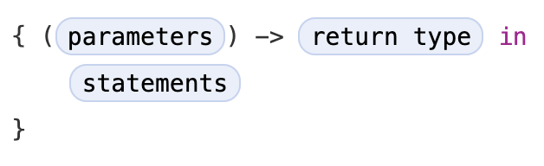
Closures
Closures are self-contained blocks of functionality that can be passed around and used in your code. Closures in Swift are similar to blocks in C and Objective-C and to lambdas in other programming languages.
Closures can capture and store references to any constants and variables from the context in which they are defined. This is known as closing over those constants and variables. Swift handles all of the memory management of capturing for you.

Slide 21
Closures
Closures take one of three forms:
Global functions are closures that have a name and don’t capture any values.
Nested functions are closures that have a name and can capture values from their enclosing function.
Closure expressions are unnamed closures written in a lightweight syntax that can capture values from their surrounding context.

Slide 22
Closures
Swift’s closure expressions have a clean, clear style, with optimizations that encourage brief, clutter-free syntax in common scenarios.
These optimizations include:
Inferring parameter and return value types from context
Implicit returns from single-expression closures
Shorthand argument names
Trailing closure syntax
Notes:
Check https://docs.swift.org/swift-book/LanguageGuide/Closures.html to see the examples of those optimizations

Slide 23
Classes

Slide 24
Structures and Classes
Structures and classes are general-purpose, flexible constructs that become the building blocks of your program’s code. You define properties and methods to add functionality to your structures and classes using the same syntax you use to define constants, variables, and functions.
Unlike other programming languages, Swift doesn’t require you to create separate interface and implementation files for custom structures and classes. In Swift, you define a structure or class in a single file, and the external interface to that class or structure is automatically made available for other code to use.
In reference to an instantiation of structure or class we will use term INSTANCE, however, if we would refer strictly to the instance of a class we will say OBJECT

Slide 25
Structures and Classes
Structures and classes in Swift have many things in common. Both can:
Define properties to store values
Define methods to provide functionality
Define subscripts to provide access to their values using subscript syntax
Define initializers to set up their initial state
Be extended to expand their functionality beyond a default implementation
Conform to protocols to provide standard functionality of a certain kind

Slide 26
Classes
Classes have additional capabilities that structures don’t have:
Inheritance enables one class to inherit the characteristics of another.
Type casting enables you to check and interpret the type of a class instance at runtime.
Deinitializers enable an instance of a class to free up any resources it has assigned.
Reference counting allows more than one reference to a class instance.

Slide 27
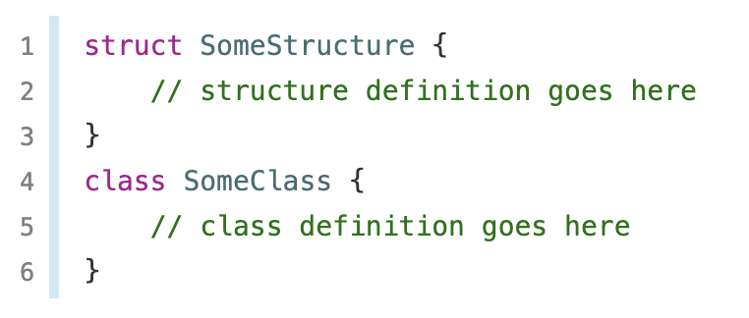
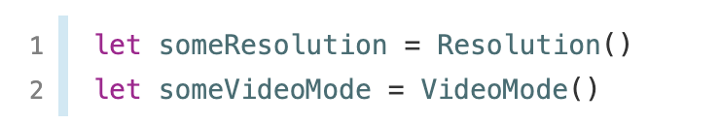
Structures and Classes
Structures and classes have a similar definition syntax. You introduce structures with the struct keyword and classes with the class keyword. Both place their entire definition within a pair of braces:

Slide 28
Value or Reference Type
Structures and Enumerations Are Value Types
A value type is a type whose value is copied when it’s assigned to a variable or constant, or when it’s passed to a function.
In fact, all of the basic types in Swift—integers, floating-point numbers, Booleans, strings, arrays and dictionaries—are value types, and are implemented as structures behind the scenes.
All structures and enumerations are value types in Swift. This means that any structure and enumeration instances you create—and any value types they have as properties—are always copied when they are passed around in your code.
Classes Are Reference Types
Unlike value types, reference types are not copied when they are assigned to a variable or constant, or when they are passed to a function. Rather than a copy, a reference to the same existing instance is used.
Because classes are reference types, it’s possible for multiple constants and variables to refer to the same single instance of a class behind the scenes.
It can sometimes be useful to find out whether two constants or variables refer to exactly the same instance of a class. To enable this, Swift provides two identity operators:
Identical to (===)
Not identical to (!==)

Slide 29
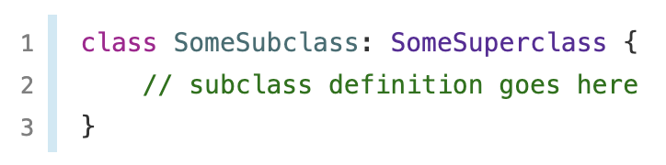
Inheritance
A class can inherit methods, properties, and other characteristics from another class. When one class inherits from another, the inheriting class is known as a subclass, and the class it inherits from is known as its superclass. Inheritance is a fundamental behavior that differentiates classes from other types in Swift.
Classes in Swift can call and access methods, properties, and subscripts belonging to their superclass and can provide their own overriding versions of those methods, properties, and subscripts to refine or modify their behavior. Swift helps to ensure your overrides are correct by checking that the override definition has a matching superclass definition.
Classes can also add property observers to inherited properties in order to be notified when the value of a property changes. Property observers can be added to any property, regardless of whether it was originally defined as a stored or computed property.

Slide 30
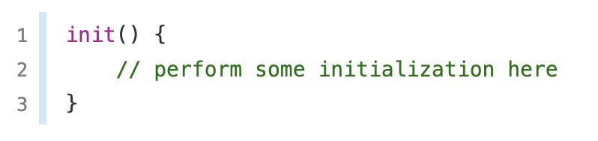
Initializers
Initializers are called to create a new instance of a particular type. In its simplest form, an initializer is like an instance method with no parameters, written using the init keyword, it may have, however, one or more parameter

Slide 31
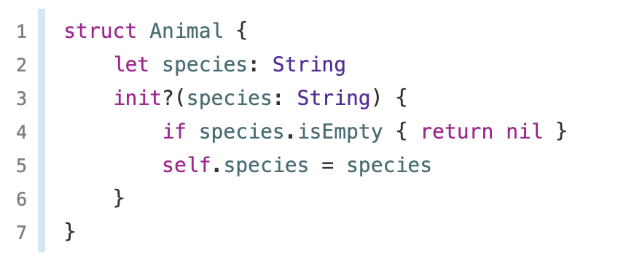
Failable Initializers
It is sometimes useful to define a class, structure, or enumeration for which initialization can fail. This failure might be triggered by invalid initialization parameter values, the absence of a required external resource, or some other condition that prevents initialization from succeeding.

Slide 32
Preventing Overrides
You can prevent a method, property, or subscript from being overridden by marking it as final. Do this by writing the final modifier before the method, property, or subscript’s introducer keyword (such as final var, final func, final class func, and final subscript).
Any attempt to override a final method, property, or subscript in a subclass is reported as a compile-time error. Methods, properties, or subscripts that you add to a class in an extension can also be marked as final within the extension’s definition.
You can mark an entire class as final by writing the final modifier before the class keyword in its class definition (final class). Any attempt to subclass a final class is reported as a compile-time error.

Slide 33
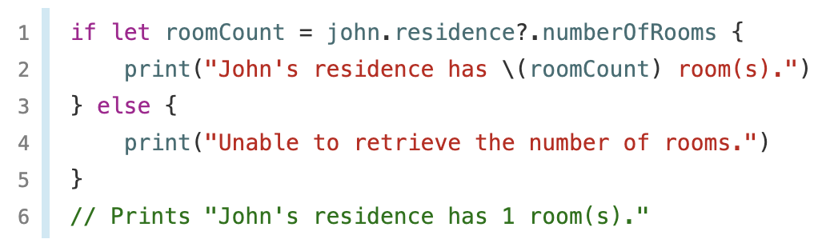
Optional chaining
Optional chaining is a process for querying and calling properties, methods, and subscripts on an optional that might currently be nil. If the optional contains a value, the property, method, or subscript call succeeds; if the optional is nil, the property, method, or subscript call returns nil. Multiple queries can be chained together, and the entire chain fails gracefully if any link in the chain is nil.

Slide 34
Error handling

Slide 35
Error handling
Error handling is the process of responding to and recovering from error conditions in your program. Swift provides first-class support for throwing, catching, propagating, and manipulating recoverable errors at runtime.
Some operations aren’t guaranteed to always complete execution or produce a useful output. Optionals are used to represent the absence of a value, but when an operation fails, it’s often useful to understand what caused the failure, so that your code can respond accordingly.
Notes:
consider the task of reading and processing data from a file on disk. There are a number of ways this task can fail, including the file not existing at the specified path, the file not having read permissions, or the file not being encoded in a compatible format. Distinguishing among these different situations allows a program to resolve some errors and to communicate to the user any errors it can’t resolve.

Slide 36
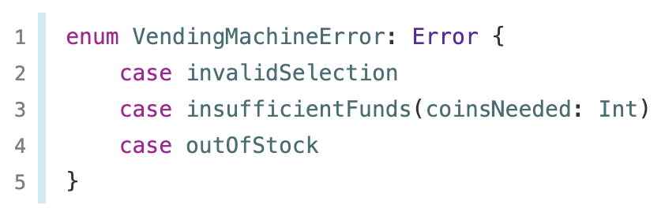
Error handling
In Swift, errors are represented by values of types that conform to the Error protocol. This empty protocol indicates that a type can be used for error handling.
Swift enumerations are particularly well suited to modeling a group of related error conditions, with associated values allowing for additional information about the nature of an error to be communicated.
Notes:
consider the task of reading and processing data from a file on disk. There are a number of ways this task can fail, including the file not existing at the specified path, the file not having read permissions, or the file not being encoded in a compatible format. Distinguishing among these different situations allows a program to resolve some errors and to communicate to the user any errors it can’t resolve.

Slide 37
Error handling
When an error is thrown, some surrounding piece of code must be responsible for handling the error—for example, by correcting the problem, trying an alternative approach, or informing the user of the failure.
There are four ways to handle errors in Swift. You can propagate the error from a function to the code that calls that function, handle the error using a do-catch statement, handle the error as an optional value, or assert that the error will not occur. Each approach is described in a section below.
When a function throws an error, it changes the flow of your program, so it’s important that you can quickly identify places in your code that can throw errors. To identify these places in your code, write the try keyword—or the try? or try! variation—before a piece of code that calls a function, method, or initializer that can throw an error. These keywords are described in the sections below.
Notes:
consider the task of reading and processing data from a file on disk. There are a number of ways this task can fail, including the file not existing at the specified path, the file not having read permissions, or the file not being encoded in a compatible format. Distinguishing among these different situations allows a program to resolve some errors and to communicate to the user any errors it can’t resolve.

Slide 38
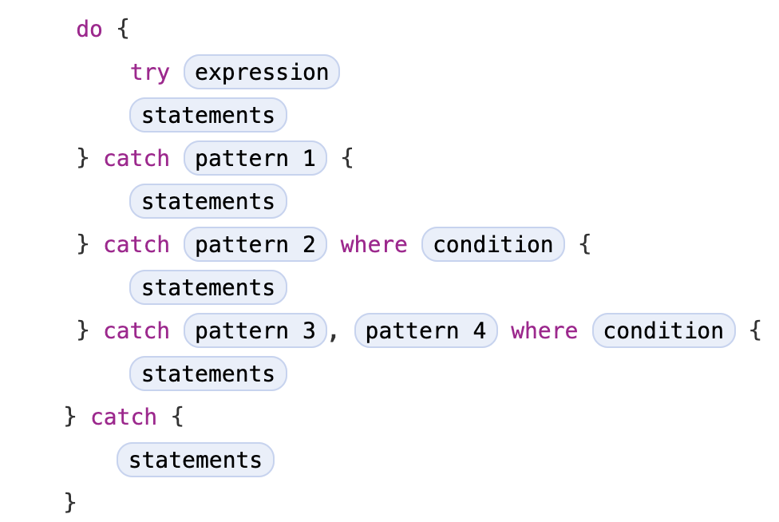
Error handling – a pattern
Notes:
Review https://docs.swift.org/swift-book/LanguageGuide/ErrorHandling.html

Slide 39
Protocols

Slide 40
Protocol
A protocol defines a blueprint of methods, properties, and other requirements that suit a particular task or piece of functionality. The protocol can then be adopted by a class, structure, or enumeration to provide an actual implementation of those requirements. Any type that satisfies the requirements of a protocol is said to conform to that protocol.
In addition to specifying requirements that conforming types must implement, you can extend a protocol to implement some of these requirements or to implement additional functionality that conforming types can take advantage of.

Slide 41
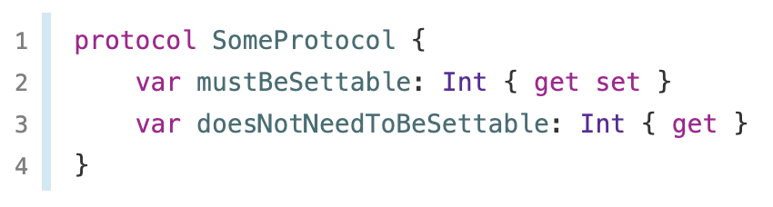
Protocol
Notes:
https://docs.swift.org/swift-book/LanguageGuide/Protocols.html

Slide 42
Property and Method Requirements
Protocol is used to specify particular class type property or instance property. It just specifies the type or instance property alone rather than specifying whether it is a stored or computed property. Also, it is used to specify whether the property is 'gettable' or 'settable'.
Property requirements are declared by 'var' keyword as property variables. {get set} is used to declare gettable and settable properties after their type declaration. Gettable is mentioned by {get} property after their type declaration.

Slide 43
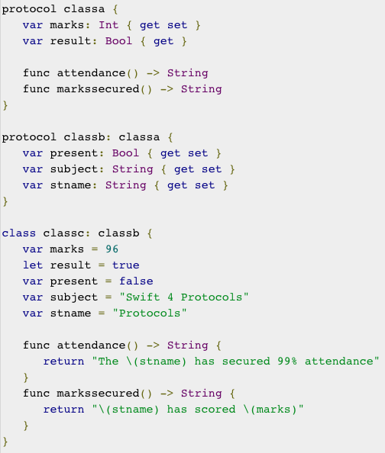
Property and Method Requirements

Slide 44
Generics

Slide 45
Generics in Swift
Generic code enables you to write flexible, reusable functions and types that can work with any type, subject to requirements that you define. You can write code that avoids duplication and expresses its intent in a clear, abstracted manner.
Generics are one of the most powerful features of Swift, and much of the Swift standard library is built with generic code. In fact, you’ve been using generics throughout the Language Guide, even if you didn’t realize it. For example, Swift’s Array and Dictionary types are both generic collections. You can create an array that holds Int values, or an array that holds String values, or indeed an array for any other type that can be created in Swift. Similarly, you can create a dictionary to store values of any specified type, and there are no limitations on what that type can be.

Slide 46
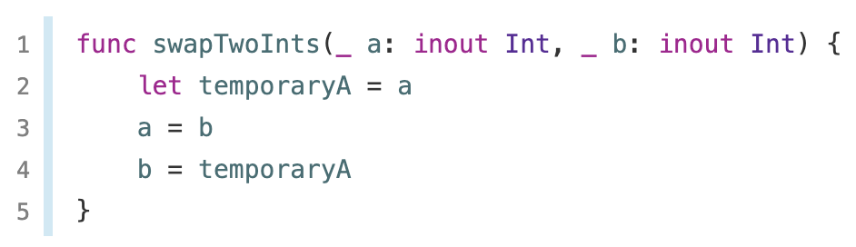
Problem
Here it is for Int, but how would it differ for String, Double, Int?, ….?

Slide 47
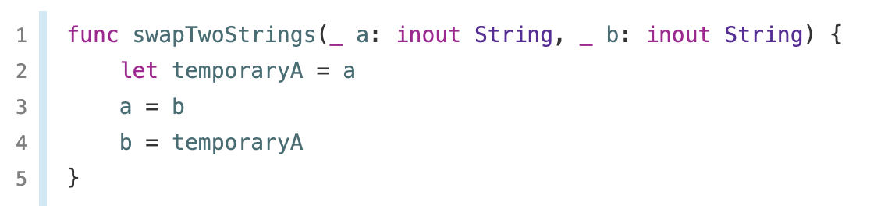
Problem
LET’S ADD A FUNCTION, AND ANOTHER, …

Slide 48
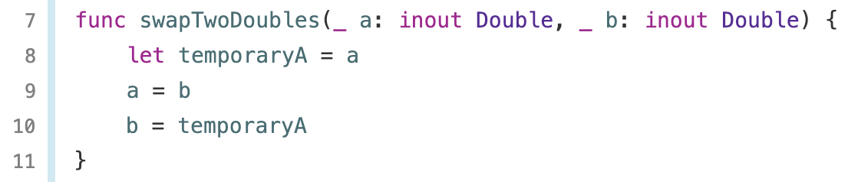
Problem
How many functions would you have to add?

Slide 49
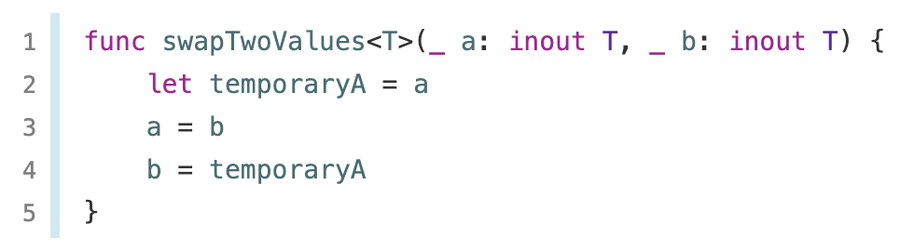
Generic functions
Generic functions can work with any type. Here’s a generic version of the swapTwoInts(_:_:) function from above, called swapTwoValues(_:_:):

Slide 50
Generic functions
The generic version of the function uses a placeholder type name (called T, in this case) instead of an actual type name (such as Int, String, or Double). The placeholder type name doesn’t say anything about what T must be, but it does say that both a and b must be of the same type T, whatever T represents. The actual type to use in place of T is determined each time the swapTwoValues(_:_:) function is called.

Slide 51
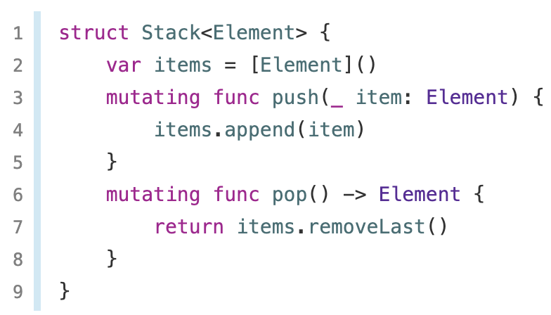
Generic Types
In addition to generic functions, Swift enables you to define your own generic types. These are custom classes, structures, and enumerations that can work with any type, in a similar way to Array and Dictionary.
Placeholder type is called this time Element

Slide 52
Access control

Slide 53
Access control
Access control restricts access to parts of your code from code in other source files and modules. This feature enables you to hide the implementation details of your code, and to specify a preferred interface through which that code can be accessed and used.
You can assign specific access levels to individual types (classes, structures, and enumerations), as well as to properties, methods, initializers, and subscripts belonging to those types. Protocols can be restricted to a certain context, as can global constants, variables, and functions.
In addition to offering various levels of access control, Swift reduces the need to specify explicit access control levels by providing default access levels for typical scenarios. Indeed, if you are writing a single-target app, you may not need to specify explicit access control levels at all.

Slide 54
Access control
Swift provides five different access levels for entities within your code.
These access levels are relative to the source file in which an entity is defined, and also relative to the module that source file belongs to.
This is a significant difference comparing to other OO languages we know such as Java or C# where access control works withing the class context.
This structure of access control requires us to structure the code in a different way

Slide 55
Access control
Open access and public access enable entities to be used within any source file from their defining module, and also in a source file from another module that imports the defining module. You typically use open or public access when specifying the public interface to a framework. The difference between open and public access is described below.
Internal access enables entities to be used within any source file from their defining module, but not in any source file outside of that module. You typically use internal access when defining an app’s or a framework’s internal structure.
File-private access restricts the use of an entity to its own defining source file. Use file-private access to hide the implementation details of a specific piece of functionality when those details are used within an entire file.
Private access restricts the use of an entity to the enclosing declaration, and to extensions of that declaration that are in the same file. Use private access to hide the implementation details of a specific piece of functionality when those details are used only within a single declaration.

Slide 56
Open vs Public
An open class can be subclassed in the module it is defined in and in modules that import the module in which the class is defined. The same applies to class members. An open method can be overridden by subclasses in the module it is defined in and in modules that import the module in which the method is defined.
This sounds very much like the public access level. That is true for Swift 2. The meaning of the public access level has changed slightly. Classes that are declared public can only be subclassed in the module they are defined in. The same applies to public class members, which can only be overridden by subclasses defined in the module they are defined in.

